Slide 1





Ontologies and CML/Compchem
Peter Murray-Rust
University of Cambridge
Discussion for Carles Bo group, Tarragona ,
2022-05-18
Talk will show a range of ontologies, demos, software, and suggestions for discussion.
Emphasizes Wikidata central role and the need to populate it with CompChem and Properties I hope to come to Tarragona in October and would be happy to run workshop/s
pm286@cam.ac.uk
peter@contentmine.org
Images from ContentMine CC BY and Wikimedia CC BY-SA

Slide 2
Data and Documents should be a continuum (Datument)
Computable Reusable
Object Narrative
Murray-Rust P, Rzepa HS: The Next Big Thing: From Hypermedia to Datuments.
J Digital Inf. 2004, 5: Article 248-2004-03-18. URL:
http://journals.tdl.org/jodi/article/view/130
Henry Rzepa
https://jcheminf.biomedcentral.com/articles/10.1186/1758-2946-5-6

Slide 3
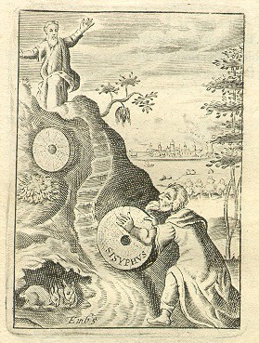
Computable Reusable
Object Narrative
CML, MathML,
SVG, Wikidata,
In-memory object
JUMBOConverters
LOSS
SMILES, MOL,
Logfiles, HTML
Jpeg, PDF, txt,
Sisyphus
Image from
Wikimedia
commons

Slide 4
Narrative
These CuO nanostructures had a large surface area, approximately 60 m2 g-1 (FACT, All components can be computed) and the effects of their enhanced active sites by nanostructuring on the electrochemical performance of CuO could be further realized by the incorporation of MWCNTs (ARGUMENT).

Slide 5
Computable Hierarchy
Syntax / Structure
Objects with identifiers
Nested objects
Relationships
Argumentation
Natural Language

Slide 6
Syntax / Structure
All components must be computable. So NO PDF, PNG or Flat Text. HTML is a minimal basis.

Slide 7
Objects/Nouns
* Most simple data is noun-based and that's the first basis of CML or CIF. The key is to - describe each object as precisely as possible - create a validation framework - provide unique identifiers (both for classes and objects) - provide Open code to carry out all common operations
Wikidata has tens of millions of identifiers for objects and classes

Slide 8
Relationships
objects are related to other objects.
MeltingPoint is linked to Pressure.
The simple language of links is RDF which is now universally supported.
Wikidata is the pre-eminent collection of links (community approved and unique identifiers). Wikidata is a superset of Open science (e.g. it contains many of the science databases)

Slide 9
Processes
P
(e.g. synthesis, measurement, computation).
Time/sequence, human and machine actions. Propose controlled natural language with embedded Objects and relations

Slide 10
Notes
Ontologies are relevant to all fields, not just compChem, so this talk is multidisciplinary
The software and techniques shown are very widely applicable
All ontologies must aim to be FAIR, and frictionless (helpful, no login).
Ontologies need software. They are computable and merge into objects and declarative programs.

Slide 11
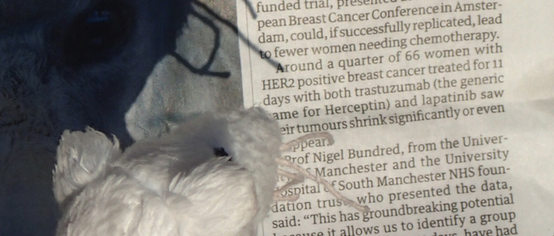
What do these mean?
Receptor
Drug
Drug
Computable Reusable Object Narrative

Slide 12
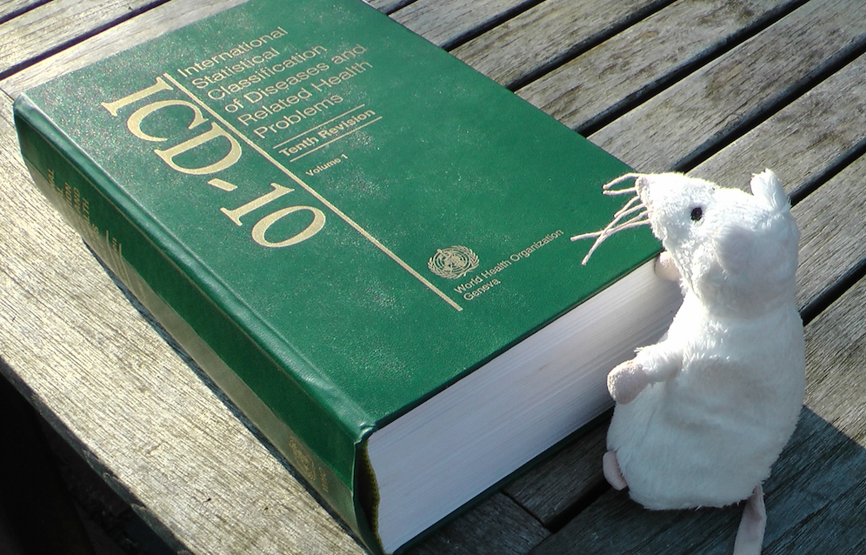
What’s an Ontology? And its purpose?
Purposes:
ICD-10 for national reporting every disease/condition
ICD-10-CM diagnosis and insurance (USA)
We use Dictionary == Ontology

Slide 13
Why ontologies?
Explanation, translation, to humans
Data validation e.g. CIF, crystallography
Data transformation , CML[1] comp. chemistry
Linking to Linked Data Cloud
Mining documents by words, e.g. lithium battery
Mining documents by data, e.g. cell dimension
Contractual process (ICD-10-CM) US insurance
Sociopolitical (DSM). Linguistic research gender
[1] Chemical Markup Language (Computable Reusable Object Narrative)

Slide 14
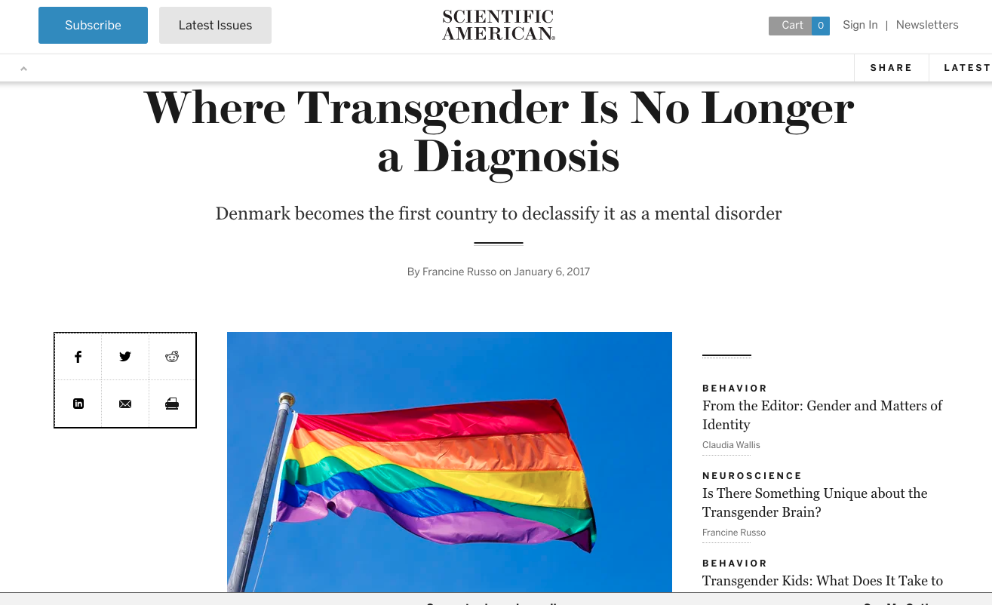
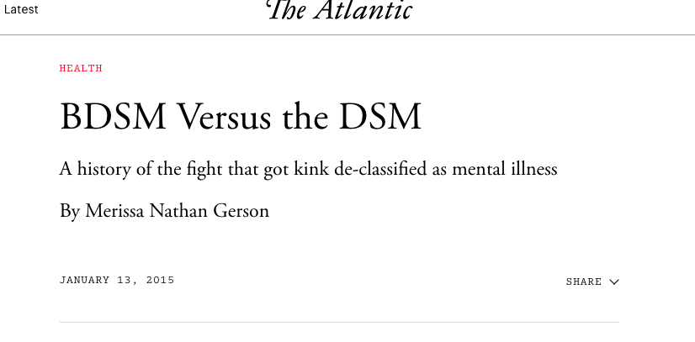
Ontologies constrain/enhance the way we think and talk
Diagnostic and Statistical Manual of Mental Disorders

Slide 15
Where do ontologies come from?
Authoritative bodies
Government and NGO (CERN, NIH, EBI)
Learned societies (IUCr)
Major labs (e.g. PNNL)
Industry
Community
Researchers [1]
Wikidata
Long-term ontologies come from years of dedicated human effort, especially as support is needed. Adoption requires consistency, running code, tutorials, support, users
[1] In our current projects (e.g. battery materials, or terpene synthases) we use multiple rapid small linked dictionaries and Wikidata

Slide 16
Ontologies in practice

Slide 17
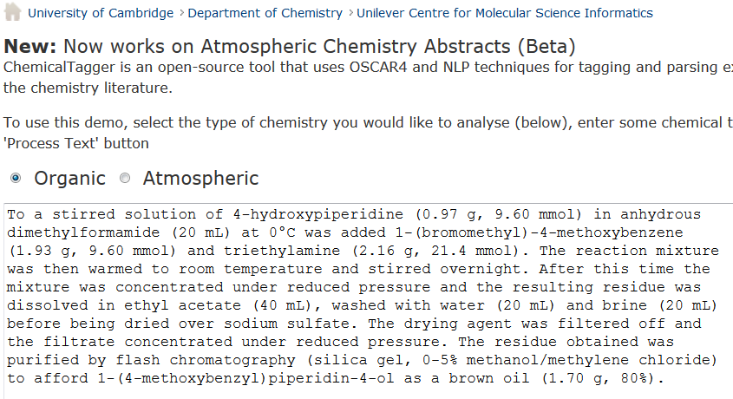
http://chemicaltagger.ch.cam.ac.uk/
Typical
Typical chemical synthesis
This contains several small annotating and parsing ontologies

Slide 18
http://chemicaltagger.ch.cam.ac.uk/
Typical
Typical chemical synthesis
This contains several small annotating and parsing ontologies

Slide 19
Materials discourse
SCIENTIFIC REPORTS | 4 : 5694 | DOI: 10.1038/srep05694
The syntheses of NiO and LiNi 0.4Mn 0.4Co 0.18Ti 0.02O 2 (NMC) were performed according to previously developed protocols 56. In short, NiO was synthesized using a solvothermal method aided with an alcohol pseudo-supercritical drying technique. NMC was synthesized using a co-precipitation method followed by high-temperature annealing with LiOH. 2032 Coin cells were fabricated using composites of NiO or NMC as working electrodes and lithium metal foils as counter electrodes. The NiO working electrodes were composed of 80 wt.% active material, 10 wt.% polyvinylidene fluoride (Kureha Chemical Ind. Co. Ltd) and 10 wt.% acetylene carbon black (Denka, 50% compressed) and loadings were typically 12 mg/cm 2 of active material. To make the electrodes, these solids were mixed into N-methyl-2-pyrrolidinone and the resulting slurry cast onto copper current collectors and dried. NMC working electrodes were prepared similarly and contained 84 wt.% active material, 8 wt.% polyvinylidene fluoride, 4 wt.% acetylene carbon black and 4 wt.% SFG-6 synthetic graphite on carbon-coated aluminum current collectors, with typical active material loadings of 67 mg/cm 2. The coin cells were assembled in a helium-filled glove box using Celgard 2400 separators and 1 M LiPF6 electrolyte in 1:2 w/w ethylene carbonate/dimethyl carbonate (Ferro Corporation). Battery testing was performed on a computer controlled VMP3 potentiostat/galvanostat (BioLogic). NiO and NMC electrodes were cycled at C/2 and C/20 rates, respectively. 1C was defined as fully discharging or charging an electrode in 1 h, corresponding to specific current densities of 718 mA/g and 280 mA/g for NiO and NMC materials, respectively.
Computable Reusable Object Narrative
Cut-n-paste into
http://chemicaltagger.ch.cam.ac.uk/
Written ca 2007 by Lezan Hawizy
Daniel Lowe wrote OPSIN (name to structure)

Slide 20
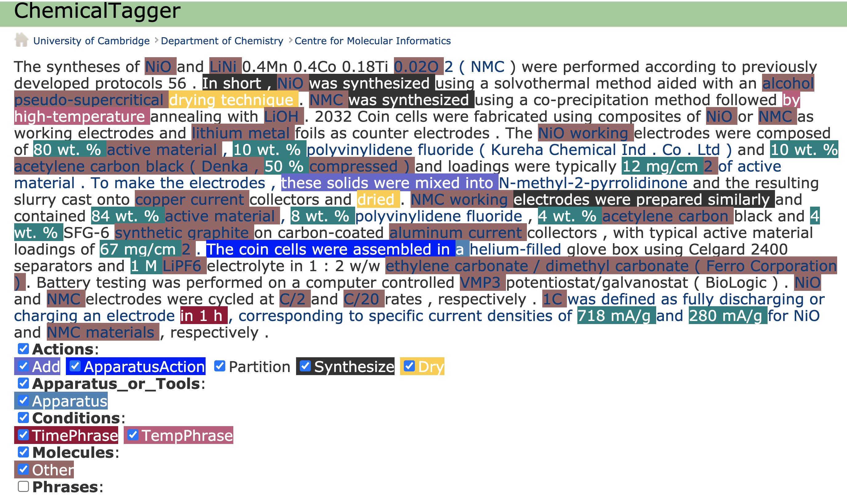
ChemicalTagger “out of the box” on Materials discourse
The unmarked fields need ontologies!

Slide 21
Crystallography: CIF where much of this began

Slide 22
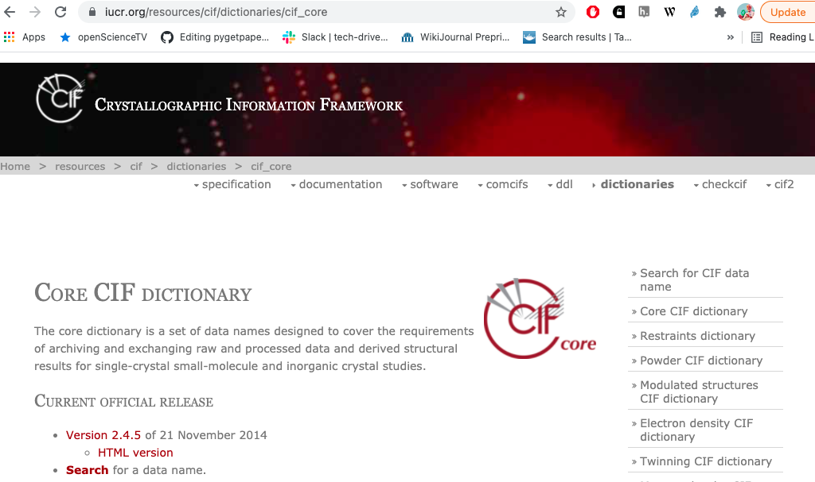
CIF: crystallographic ontology – a model beyond formats
In the late [1970s] the IUCr Commissions […] promoted the development of the Standard Crystallographic File Structure
“Framework” (model) , not “file”
[late 1980s] IUCr promoted the submission of data
in machine-readable form
30 years !
Hall SR, Allen FH, Brown ID (1991). "The Crystallographic Information File (CIF):
a new standard archive file for crystallography". Acta Crystallographica Section A. 47 (6):
655–685. doi:10.1107/S010876739101067X.

Slide 23
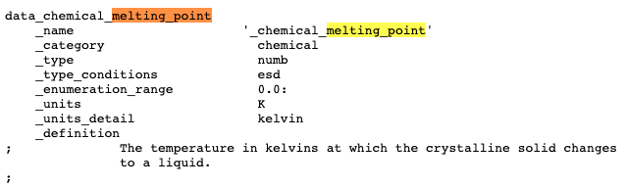
Typical CIF data entry
Container of Name-value pairs
Unique_id
Classification
Datatype
Error limits
Allowed range
Mandated units
CIF Supports:
Editing
Checking
Transformation
Human discourse
Data can be mixed with text (LaTeX)

Slide 24
Typical CIF data entry
Container of Name-value pairs
Unique_id
Classification
Datatype
Error limits
Allowed range
Mandated units
Computable Reusable Object
CIF Supports:
Editing
Checking
Transformation
Human discourse
Data can be mixed with text (LaTeX)
Computable Reusable Object

Slide 25
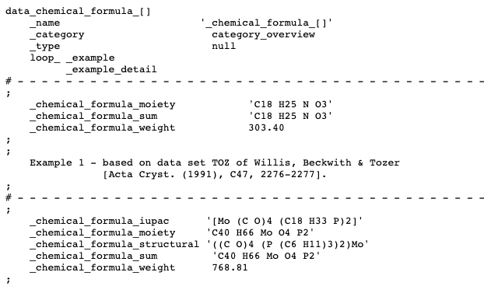

Slide 26
Communal ontologies
DBpedia – a dataset containing extracted data from Wikipedia; it contains about 3.4 million concepts described by 1 billion triples, including abstracts in 11 different languages
GeoNames – provides RDF descriptions of more than 7,500,000 geographical features worldwide.
Wikidata – a collaboratively-created linked dataset that acts as central storage for the structured data of its Wikimedia Foundation sister projects
Global Research Identifier Database (GRID) – an international database of 89,506 institutions engaged in academic research
Anything valuable will get incorporated into Wikidata!

Slide 27
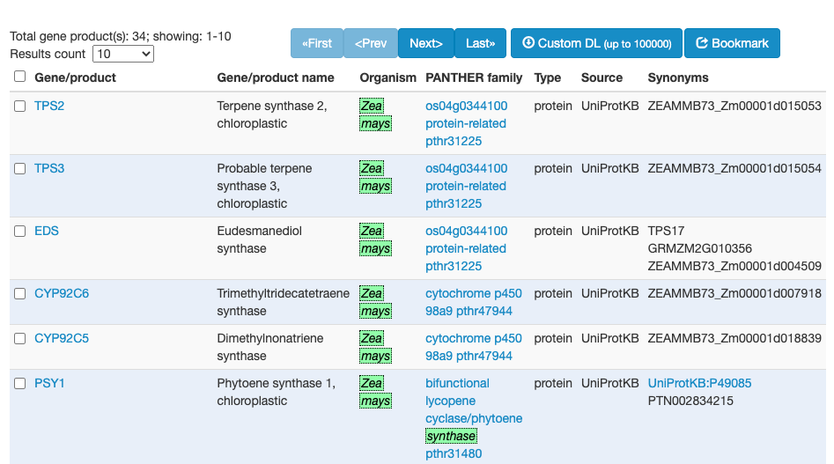
Gene Ontology (GO) and browser links Species, Genes and Proteins
Gene Product
Proteins
Maize

Slide 28
Wikidata in Linked OpenData cloud

Slide 29
Wikidata in Linked OpenData cloud
Computable Reusable Objects

Slide 30
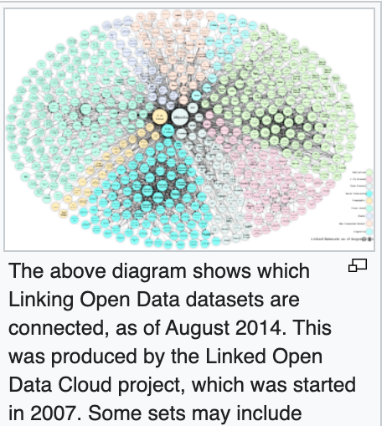
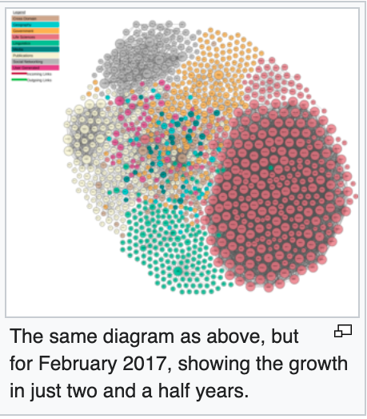
https://en.wikipedia.org/wiki/Linked_data

Slide 31
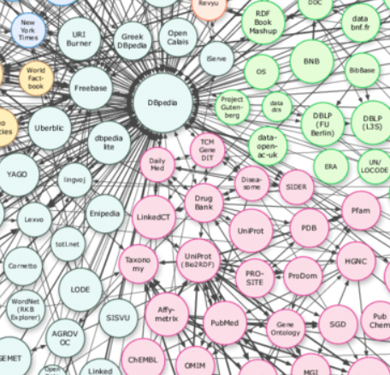
DBPedia 2007
Collection of
links in Wikipedia
DBpedia
Computable Reusable Objects
Drugbank
UniProt
PDB
Gene
Ontolopgy
PubChem
ChEMBL

Slide 32
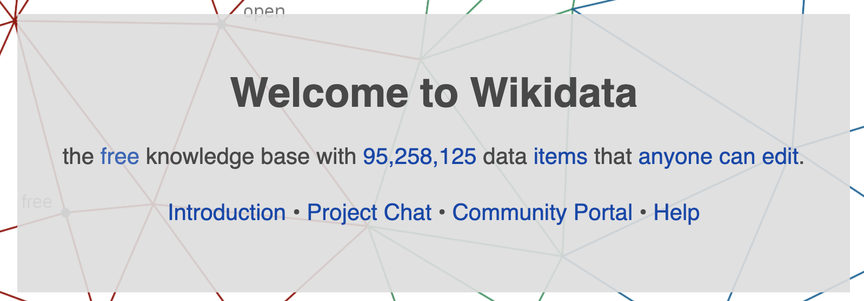
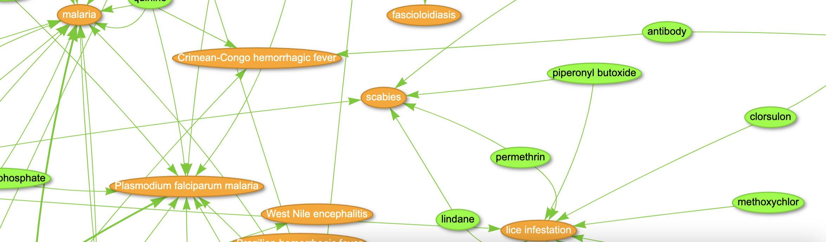
https://query.wikidata.org/
https://query.wikidata.org/#%23A%20network%20of%20Drug-disease%20interactions%20on%20infectious%20diseases%20%28Source%3A%20Disease%20Ontology%2C%20NDF-RT%20and%20ChEMBL%29%0A%23defaultView%3AGraph%0ASELECT%20DISTINCT%20%3Fitem%20%3FitemLabel%20%3Frgb%20%3Flink%0AWHERE%0A%7B%0A%20%20VALUES%20%3Ftoggle%20%7B%20true%20false%20%7D%0A%20%20%3Fdisease%20wdt%3AP699%20%3Fdoid%3B%0A%20%20%20%20%20%20%20%20%20%20%20wdt%3AP279%2B%20wd%3AQ18123741%3B%0A%20%20%20%20%20%20%20%20%20%20%20wdt%3AP2176%20%3Fdrug.%0A%20%20%3Fdrug%20rdfs%3Alabel%20%3FdrugLabel.%0A%20%20%20%20FILTER%28LANG%28%3FdrugLabel%29%20%3D%20%22en%22%29.%0A%20%20%3Fdisease%20rdfs%3Alabel%20%3FdiseaseLabel.%0A%20%20%20%20FILTER%28LANG%28%3FdiseaseLabel%29%20%3D%20%22en%22%29.%0A%20%20BIND%28IF%28%3Ftoggle%2C%3Fdisease%2C%3Fdrug%29%20AS%20%3Fitem%29.%0A%20%20BIND%28IF%28%3Ftoggle%2C%3FdiseaseLabel%2C%3FdrugLabel%29%20AS%20%3FitemLabel%29.%0AGraph%0A%0A%20%20BIND%28IF%28%3Ftoggle%2C%22FFA500%22%2C%227FFF00%22%29%20AS%20%3Frgb%29.%0A%20%20BIND%28IF%28%3Ftoggle%2C%22%22%2C%3Fdisease%29%20AS%20%3Flink%29.%0A%7D
#A network of Drug-disease interactions on infectious diseases (Source: Disease Ontology, NDF-RT and ChEMBL)
#defaultView:Graph
SELECT DISTINCT ?item ?itemLabel ?rgb ?link
WHERE
{
VALUES ?toggle { true false }
?disease wdt:P699 ?doid;
wdt:P279+ wd:Q18123741;
wdt:P2176 ?drug.
?drug rdfs:label ?drugLabel.
FILTER(LANG(?drugLabel) = "en").
?disease rdfs:label ?diseaseLabel.
FILTER(LANG(?diseaseLabel) = "en").
BIND(IF(?toggle,?disease,?drug) AS ?item).
BIND(IF(?toggle,?diseaseLabel,?drugLabel) AS ?itemLabel).
Graph
BIND(IF(?toggle,"FFA500","7FFF00") AS ?rgb).
BIND(IF(?toggle,"",?disease) AS ?link).
}

Slide 33
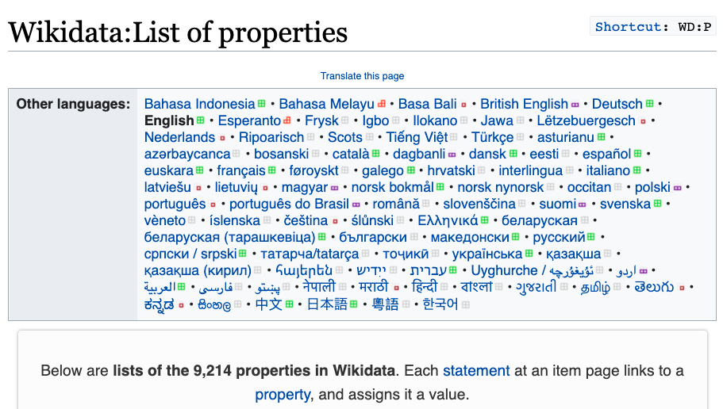
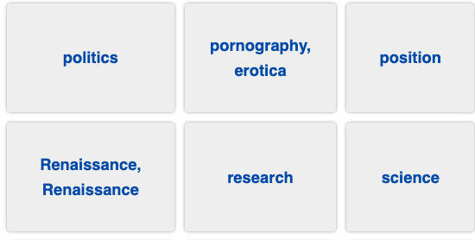

Slide 34
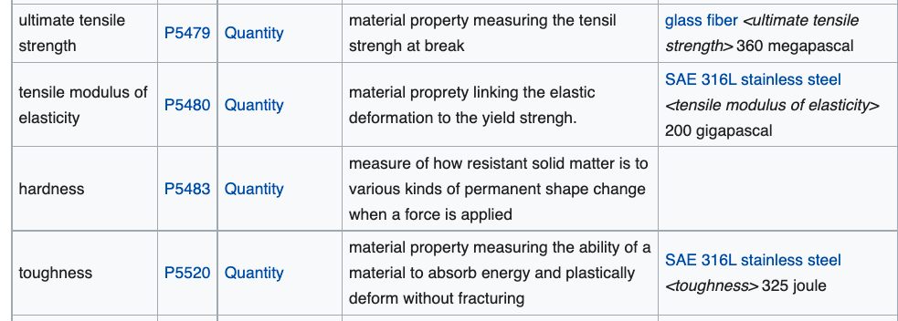
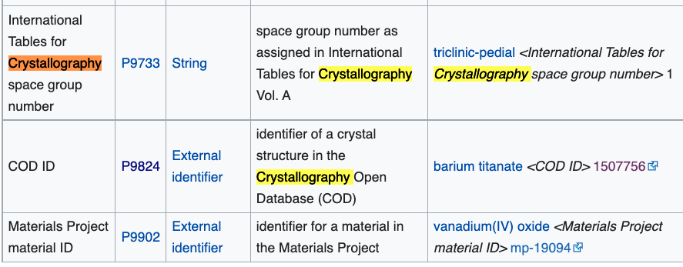

Slide 35
Example Wikidata Query
https://query.wikidata.org/
https://query.wikidata.org/#%23Cats%2C%20with%20pictures%0A%23defaultView%3AImageGrid%0ASELECT%20%3Fitem%20%3FitemLabel%20%3Fpic%0AWHERE%0A%7B%0A%3Fitem%20wdt%3AP31%20wd%3AQ146%20.%0A%3Fitem%20wdt%3AP18%20%3Fpic%0ASERVICE%20wikibase%3Alabel%20%7B%20bd%3AserviceParam%20wikibase%3Alanguage%20%22%5BAUTO_LANGUAGE%5D%2Cen%22%20%7D%0A%7D

Slide 36
Search, annotation, mining

Slide 37
Creating materials dictionary
(from 200 Li-ion papers)
<entry term="mA" count="980"/>
<entry term="J." count="844"/>
<entry term="LIB" count="680"/>
<entry term="XRD" count="566"/>
<entry term="SEI" count="522"/>
<entry term="LFP" count="516"/>
<entry term="TEM" count="442"/>
Docanalysis program (Shweata N Hegde)

Slide 38
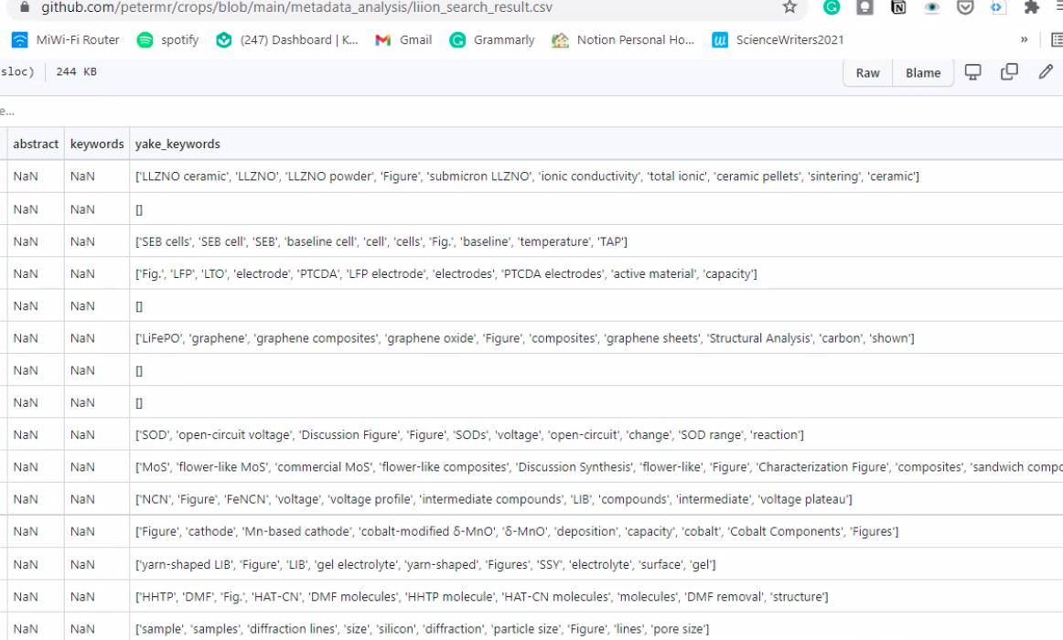
Unsupervised Extraction of phrases from 100 papers( YAKE, SciSpacy)
LLZNO ceramic
Ceramic pellets
Graphene
Active material
Open circuit
DMF molecules
Voltage plateau
(Shweata N Hegde, Mysore)

Slide 39
Unsupervised Extraction of phrases from 100 papers( YAKE, SciSpacy)
LLZNO ceramic
Ceramic pellets
Graphene
Active material
Open circuit
Computable Reusable Objects
DMF molecules
Voltage plateau
(Shweata N Hegde, Mysore)

Slide 40
We make a simple dictionary for materials
<dictionary title="materials">
<entry term="anode" wikipedia="anode" wikidata="Q181232" description="electrode through which conventional current flows into a polarized electrical device"/>
<entry term="cathode" wikidata="Q175233" description="electrode from which …"/>
<entry term="current density" wikidata="Q77680811”/> …

Slide 41
Annotation using Dictionaries
file="liion/PMC4062906/methods/search/elements/results.xml">
<result pre="foil and dried at 80°C under vacuum for 5 h." exact="Lithium" post="sheet was served as counter and reference …"/>
methods = section
PMC4062906 = reference
elements = dictionary
(annotation to W3C spec)

Slide 42
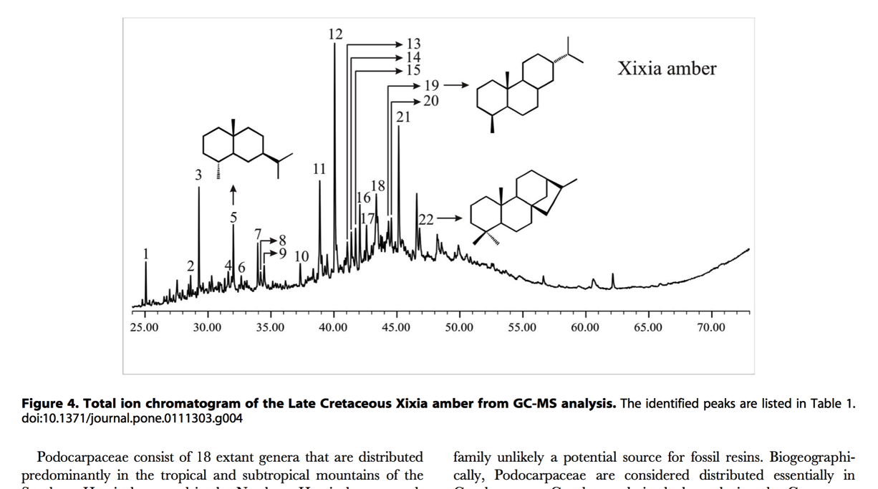
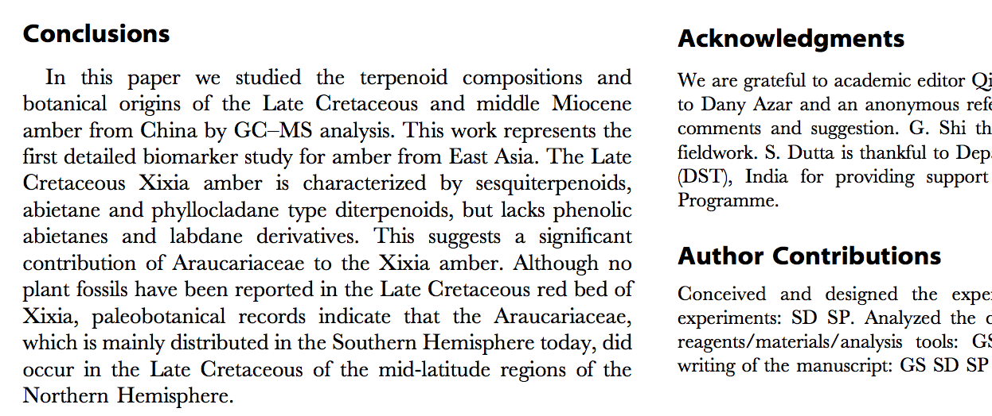
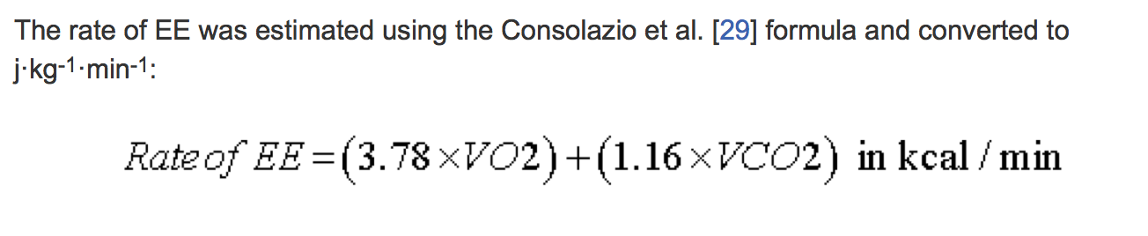
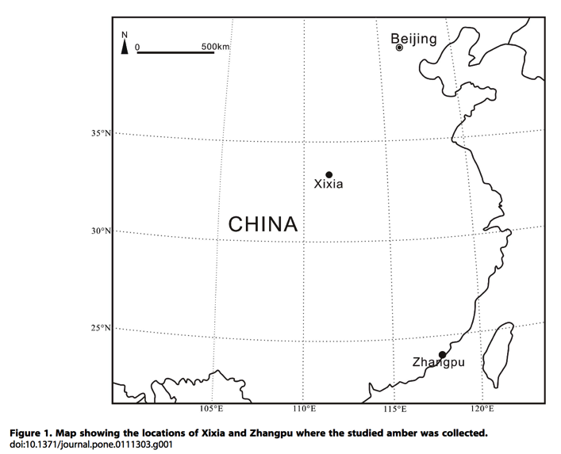
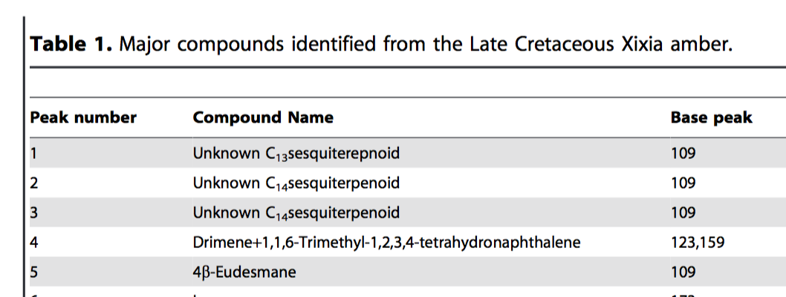
What is “Content”?
TEXT
CHEMISTRY
MATH
SECTIONS
contentmine.org tackles these
TABLES
MAPS
http://www.plosone.org/article/fetchObject.action?uri=info:doi/10.1371/journal.pone.0111303&representation=PDF CC-BY

Slide 43
What is “Content”?
CML
TEXT
CHEMISTRY
HTML
MathML
SECTIONS
MATH
Computable Reusable Objects
contentmine.org tackles these
GML
Pandas, R, etc.
TABLES
MAPS
CML
http://www.plosone.org/article/fetchObject.action?uri=info:doi/10.1371/journal.pone.0111303&representation=PDF CC-BY

Slide 44
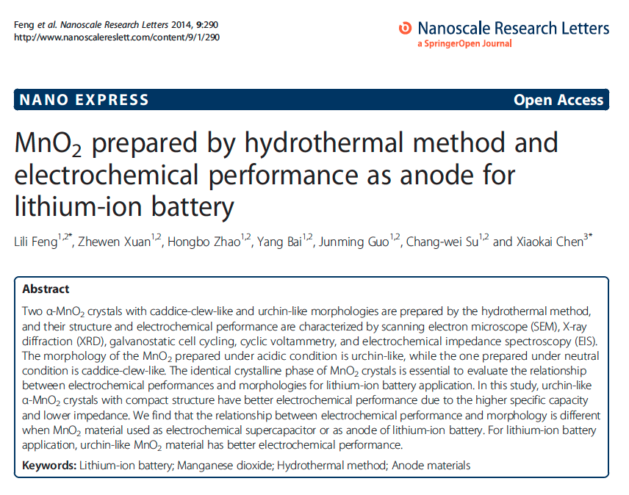
Typical Materials Science Paper
getpapers -q "lithium-ion battery" -n
info: Searching using eupmc API
info: Found 3305 open access results

Slide 45
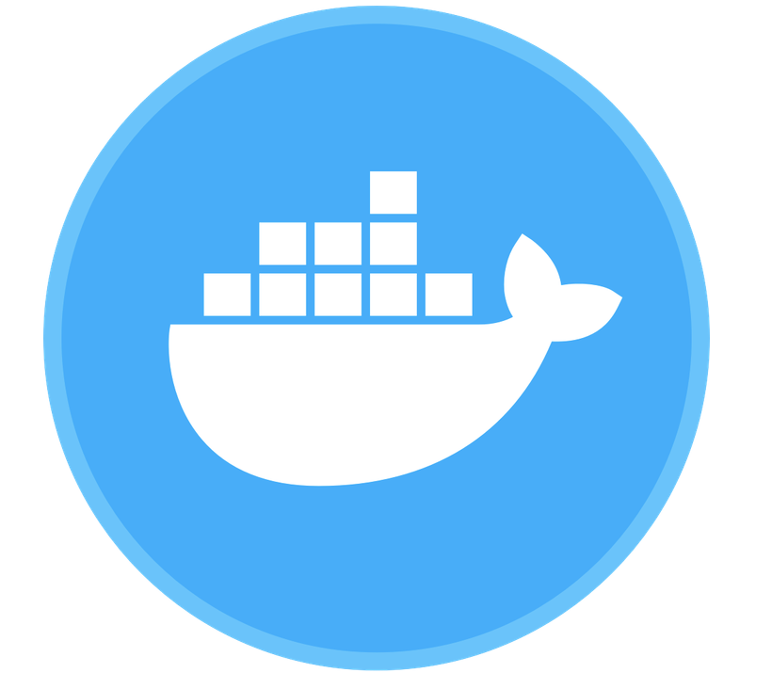
ContentMine Tools
scrape
clean
annotate
display
framework: ami + CProject data
scrapers: getpapers, Ferret, curl, scrapy
cleaners: PDFBox, Tidy/Jsoup, etc. Grobid
transformers: xml2html, ami ocr, KNIME
dictionaries: ami dictionary
indexing and annotation: Solr, ami
Analysis and display: R, KNIME

Slide 46
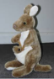
abstract
Captioned
Figures
methods
Fig. 1
MINING
with sections
and dictionaries
HTML tables
references
abstract
Captioned
Figures
Dict A
Fig. 1
Image
Caption
methods
HTML tables
Dict B
references
Table
Caption
[W3C Annotation / https://hypothes.is/ ]

Slide 47
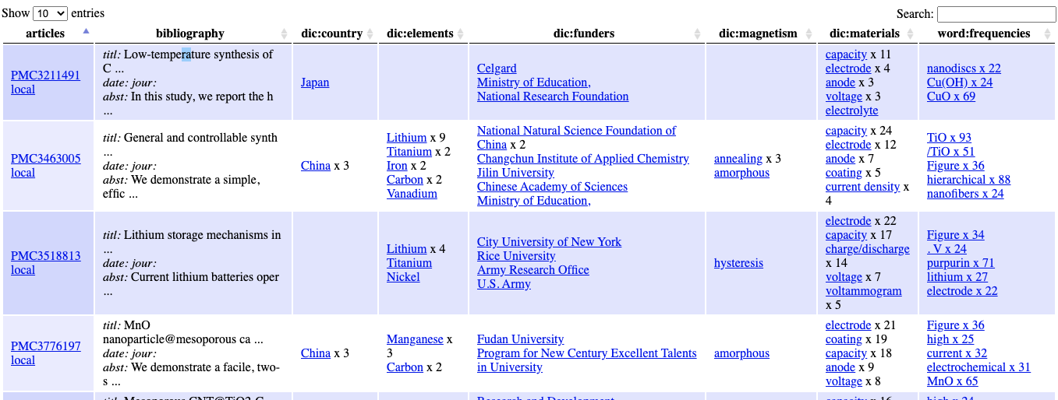
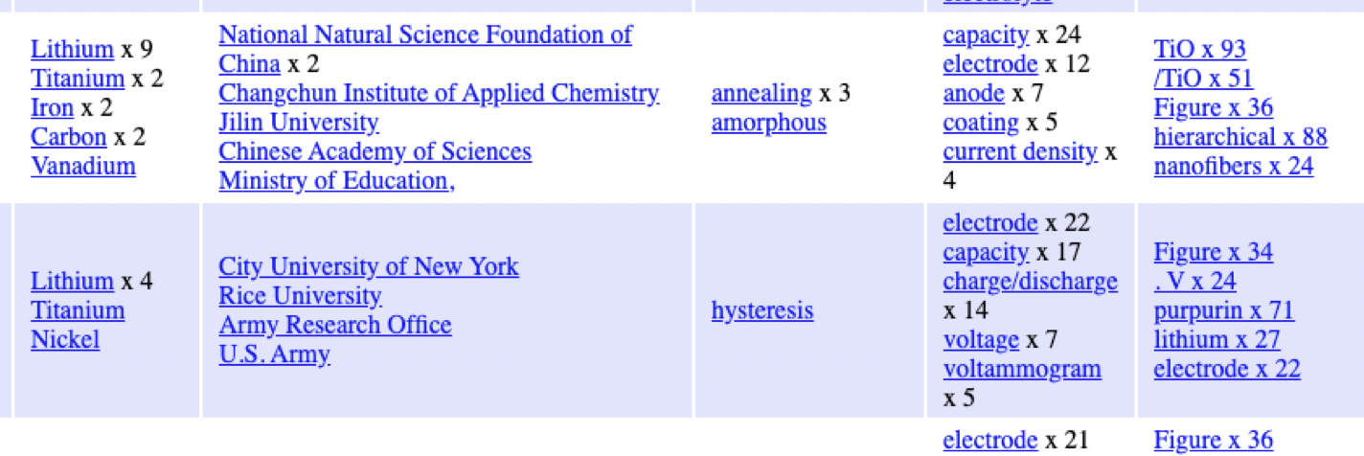
Dashboard of 200 articles searched with 5 dictionaries
biblio
country
element
funder
magnetism
battery

Slide 48
Dashboard of 200 articles searched with 5 dictionaries
biblio
country
element
funder
magnetism
battery
Computable Reusable Objects

Slide 49
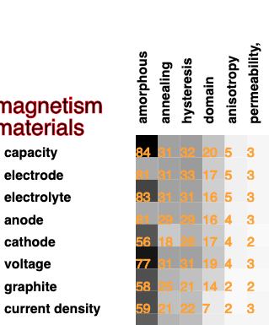
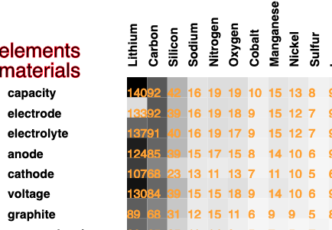
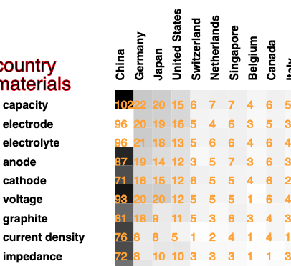
Downstream Computation:
Co-occurrence of words

Slide 50
Mining images with ontologies

Slide 51
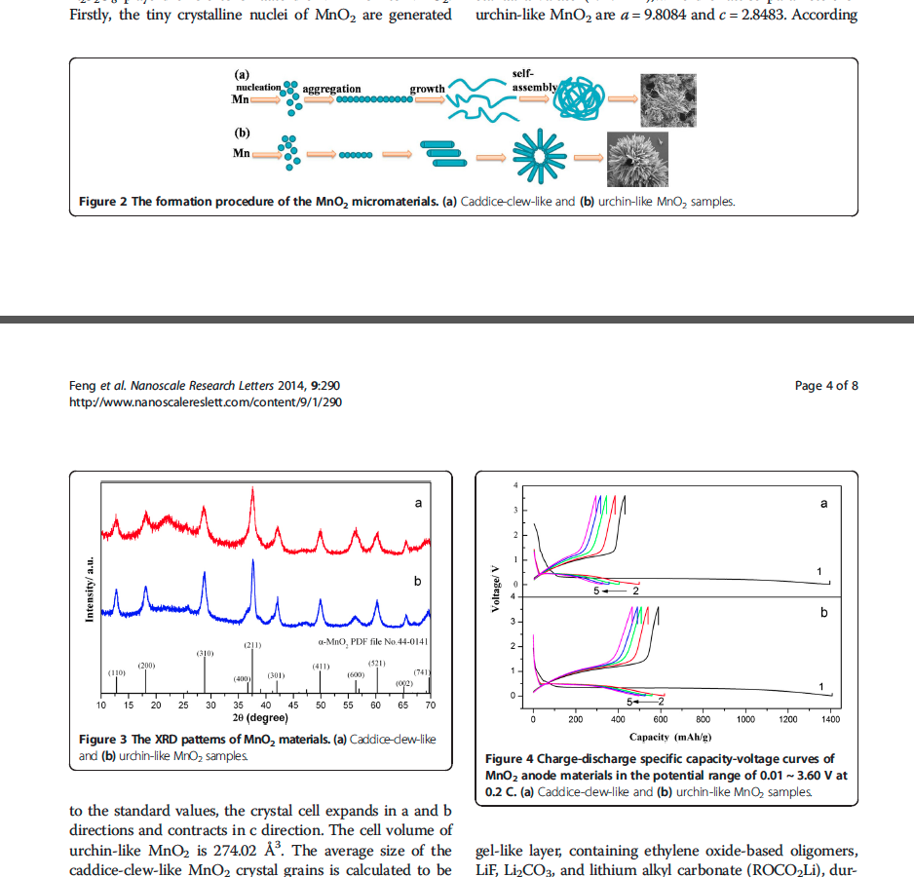
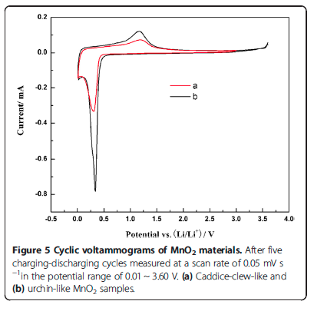
Can we get anything useful with automatic tools?
Work with Matthew Dunstan, Cambridge –
Cyclic voltammetry of battery materials

Slide 52
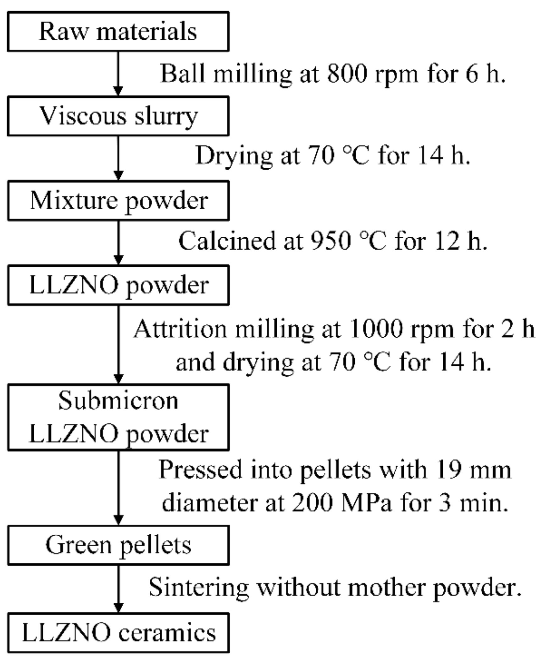
Mining text from images with Tesseract
Raw materials
Ball milling at 800 rpm for 6 h.
Drying at 70 °C for 14h.
Mixture powder
Calcined at 950 °C for 12 h.
LLZNO powder
Attrition milling at 1000 rpm for 2 h and
drying at 70 °C for 14 h.
Submicron LLZNO powder
Pressed into pellets with 19 mm diameter at
200 MPa for 3 min.
Green pellets
Sintering without mother powder.
LLZNO ceramics
Figure
Extracted text

Slide 53
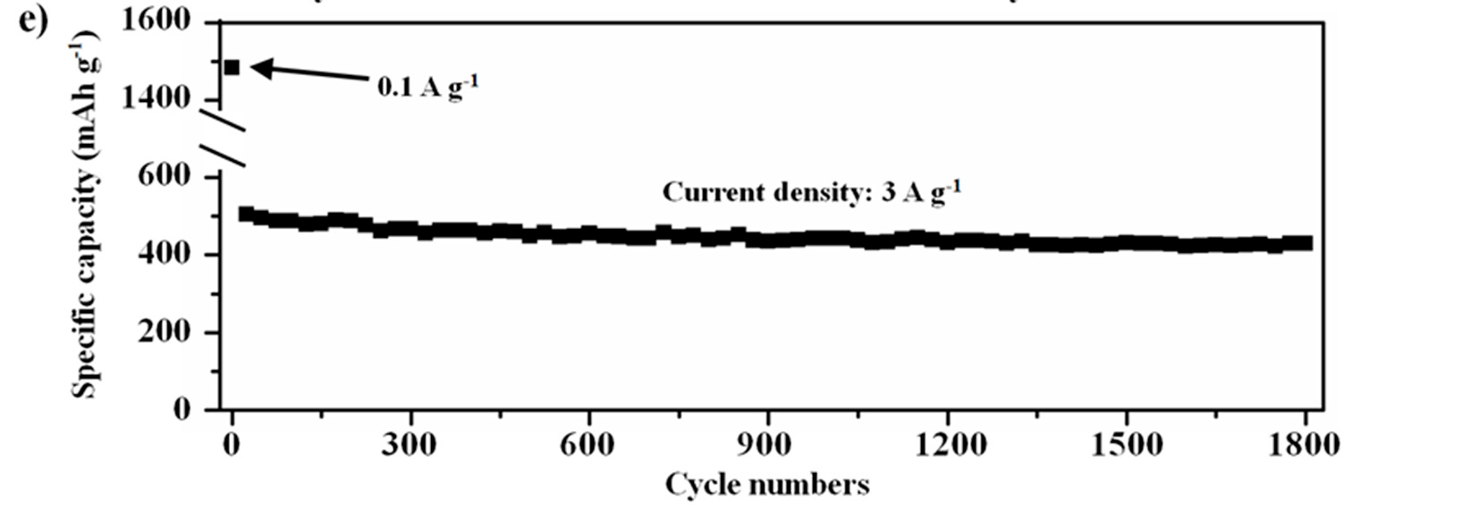
Mining data from plots
1600
1400
600
400
200
0
Current density: 3 Ag?
Specific capacity (mAh g!
0 300 600 900 1200 1500 1800
Cycle numbers
An ontology with units would easily fix the errors

Slide 54
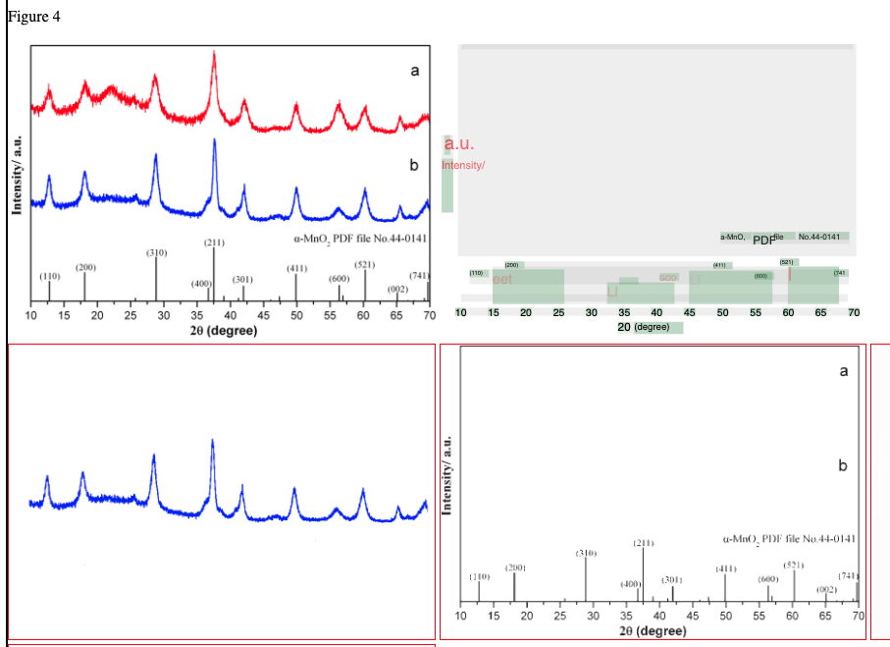
Extraction of data from diagrams

Slide 55
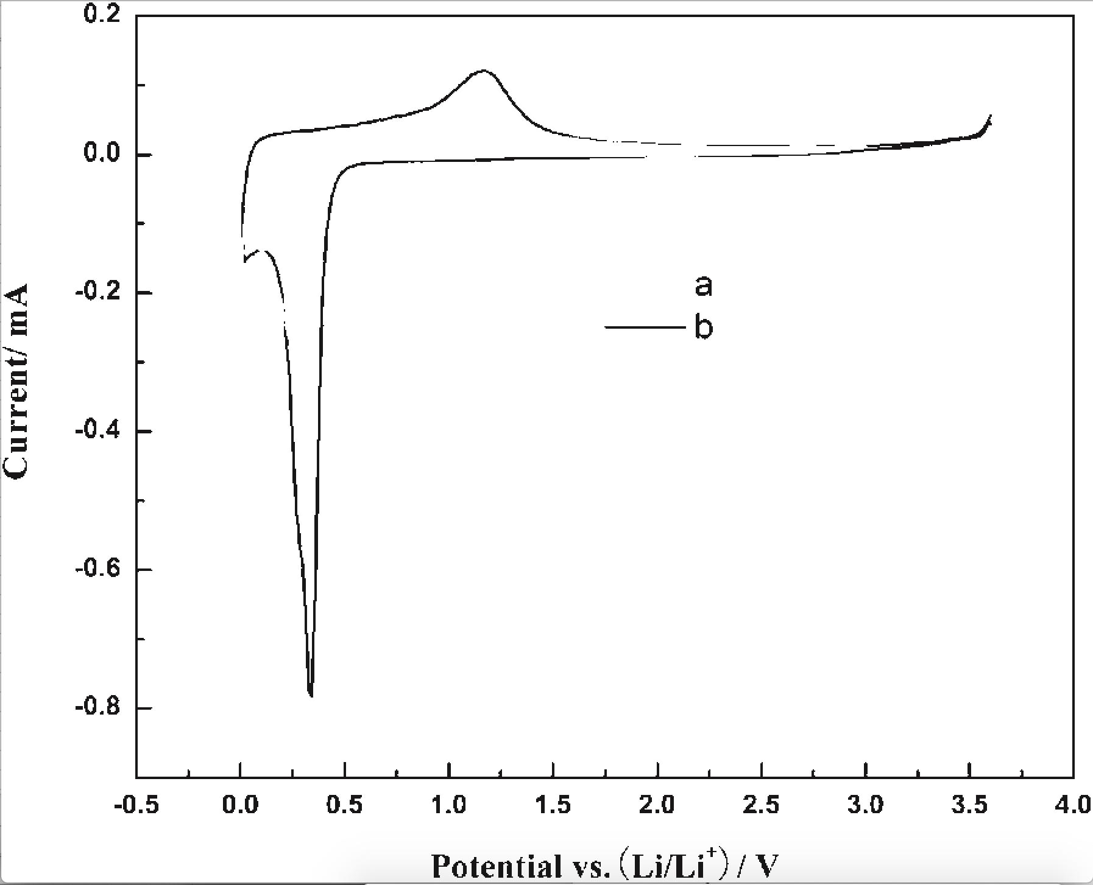
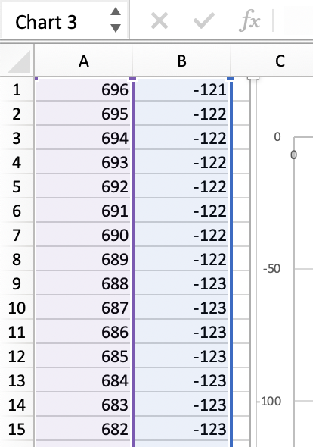
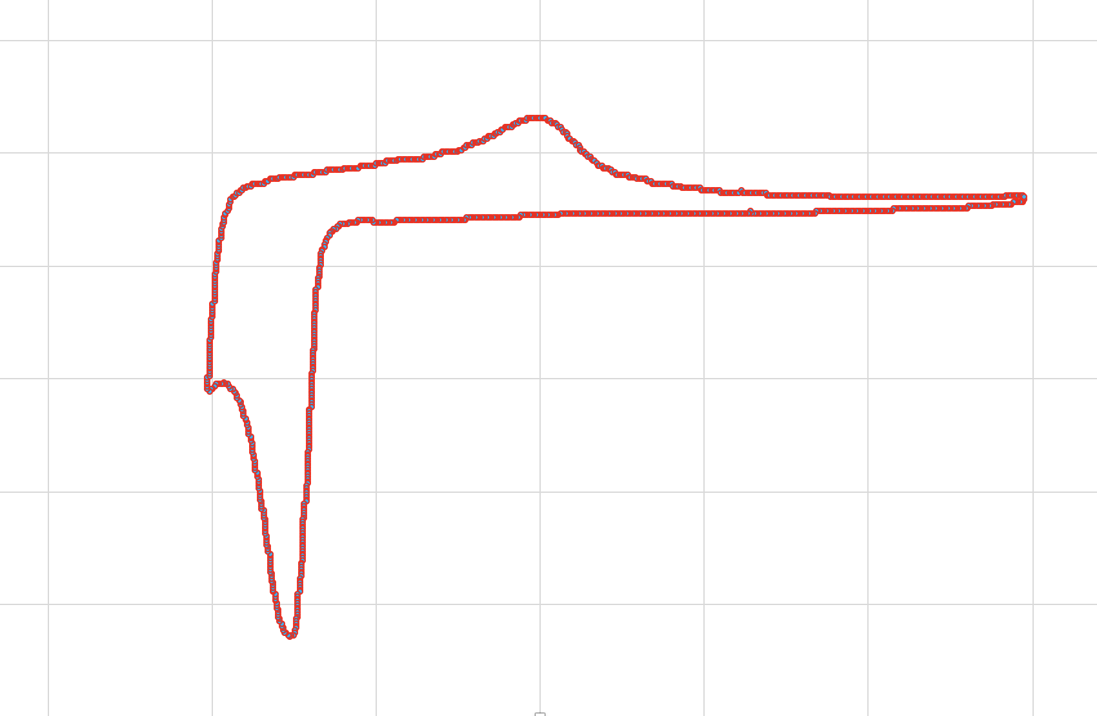
Extraction of data from diagrams
ami-image
ami-pixel

Slide 56
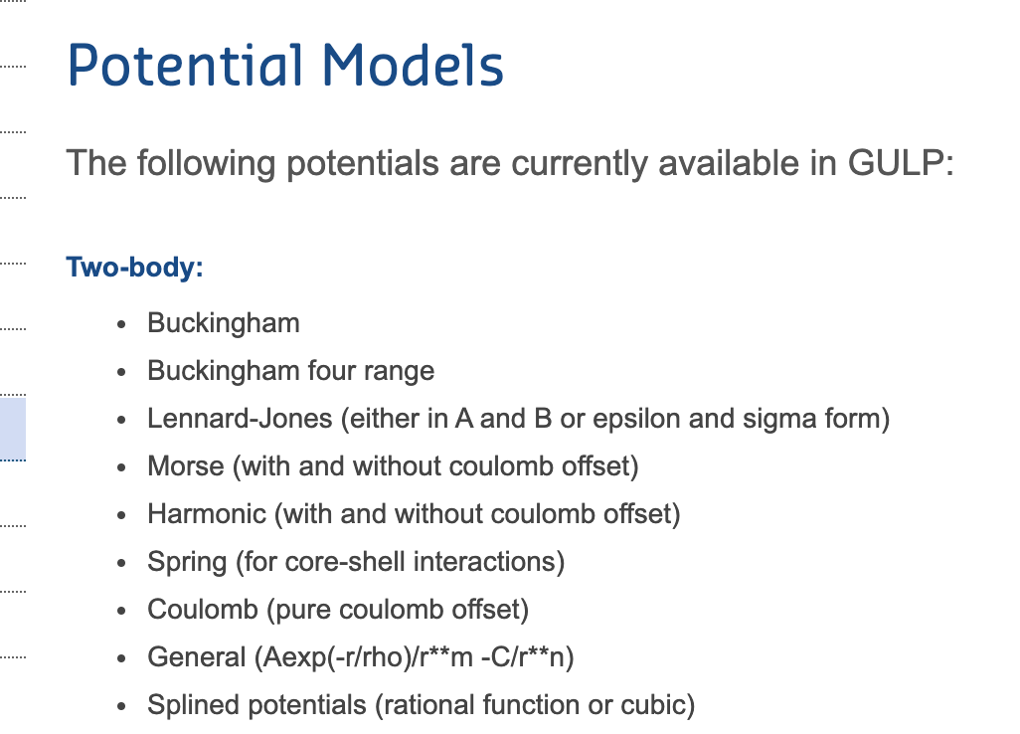
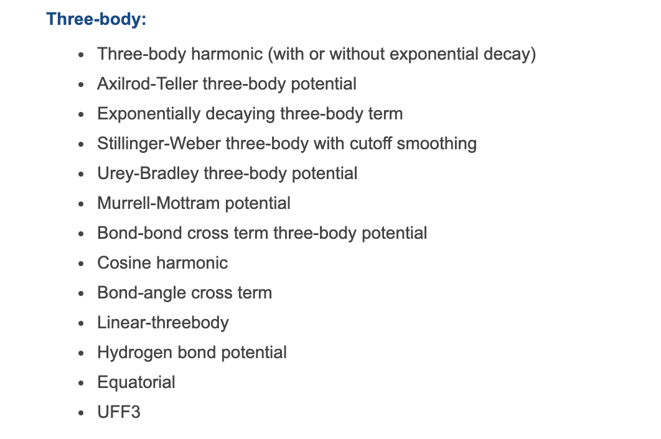
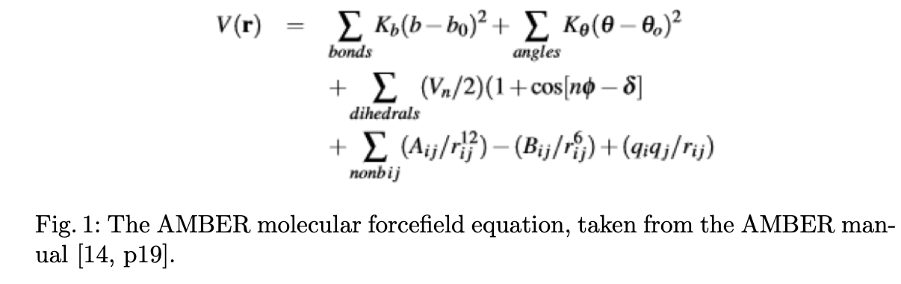
Force fields need a computable ontology

Slide 57
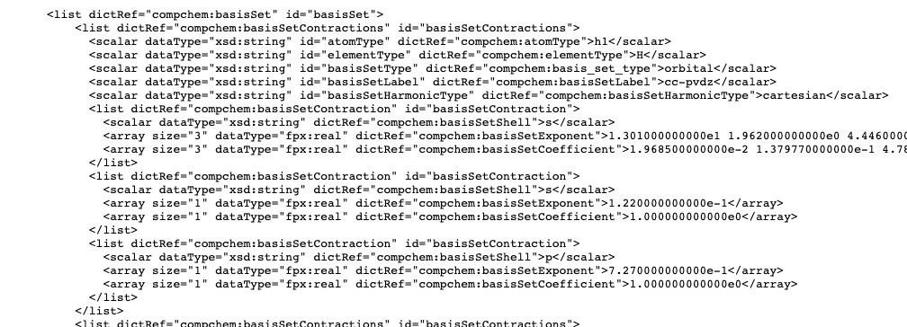
Chemical Markup Language (CML) + dictionaries supports
chemistry as a computable ontology
CompChem Logfile
Reactions
Spectra
Crystallography and nano
Polymers
Computational chemistry

Slide 58
CML + dictionaries supports
chemistry as a computable ontology
CompChem Logfile
(VASP, CASTEP, etc…
Computable Reusable Object Narrative
Reactions
Spectra
Crystallography and nano
Polymers
Computational chemistry

Slide 59
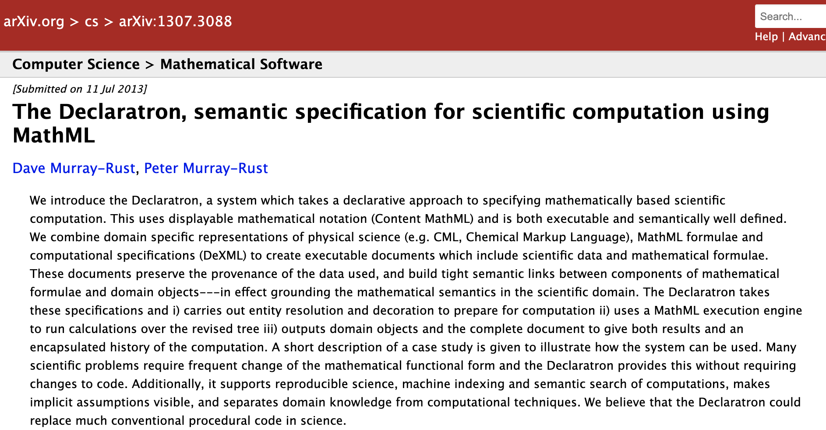
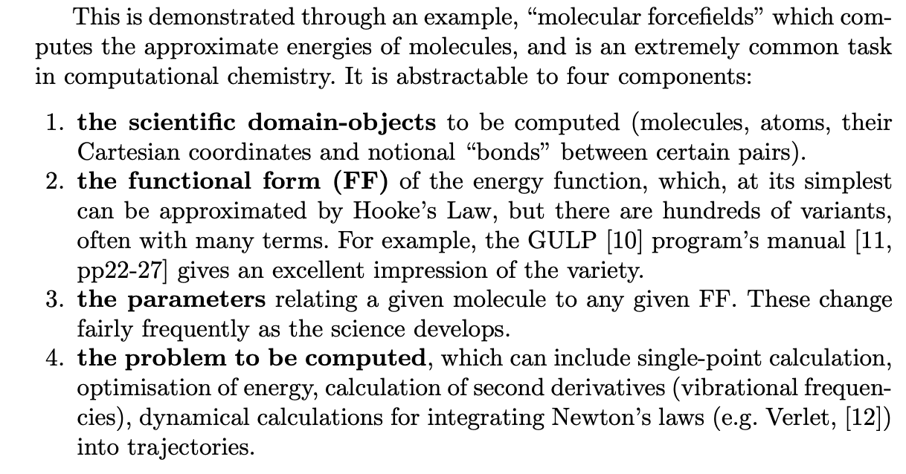

Slide 60
Computable Reusable Object Narrative

Slide 61
Thanks:
Mathew Dunstan: Batteries
Shweata N Hegde: word extractions
Ayush Garg: pygetpapers
Lezan Hawizy: ChemicalTagger
Daniel Lowe: OPSIN
All tools (mining, ontologies, etc.) are Open.
Happy to collaborate.
pm286@cam.ac.uk
https://github.com/petermr : many repositories

